Slide 1

Consumer Confidence

Slide 2
Consumer Confidence
The aims of this lesson are to:
Identify the main points of Consumer Confidence
Evaluate what initiatives and incentives are available to overcome the barriers to trading via e-Commerce
Be able to identify how this relates to your chosen organisation and how they have overcome the barriers to trading via e-commerce
National Diploma Yr1

Slide 3
Consumer Confidence
In pairs or small groups discuss ideas of the types of barriers organisations may face when trading via E-Commerce and how they may overcome these

Slide 4
Barriers that may be faced when trading via E-Commerce
Cant see/touch the goods
No Face to face Customer Service
Having faith in a site i.e. who else uses it
Ease of use
How secure is the site for payments

Slide 5
How the barriers that may be faced when trading via E-Commerce can be overcome
360 degree Demonstrations
Good customer Service
Forums
Security logos
Customer Review
Ratings i.e. how many people have visited the site
Ease of use
Sales promotions

Slide 6
How to Attract your audience
http://news.bbc.co.uk/1/hi/programmes/click_online/7915108.stm

Slide 7
How to Attract your audience
HSBC Bank
http://www.hsbc.co.uk/1/2/security-centre/secure-key/tv-ad
Forums
http://forums.ebuyer.com/
360 degree shot of camera
http://www.ebuyer.com/206656-free-multifunction-printer-samsung-st45-12mp-digital-camera-st45

Slide 8
How to Attract your audience
Monarch
Live Videos
http://www.monarch.co.uk/sri-lanka#Video_container
First Choice
Ratings
http://www.firstchoice.co.uk/holidays/mexico-caribbean-coast-holidays/riviera-maya/excellence-playa-mujeres/

Slide 9
Personalisation
It is crucial for organisations to be able to identify their customers on an individual level.
To gather all possible information about them, with the purpose of knowing their market.
This will then enable them to develop and personalise their products and services.

Slide 10
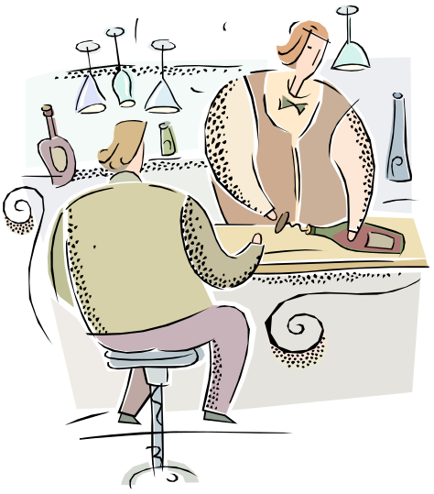
Customer Service
Customer service is one of the necessary and
Required activities among the support functions
needed in transactional situations.
Time is essential. You should never keep your
customers waiting for too long and
always update them on delivery schedules

Slide 11

Community
The customers / clients of a business can be seen
as part of a community where they interact
(either independently or influenced by the
marketer)

Slide 12
Security
Security during transactions performed on a website, where we have to take all possible precautions that third parties will not be able to access any part of a developing
transaction.
security of data collected and stored, about our customers and visitors.

Slide 13
Individual Task
Document the types of initiatives and incentives that can be used by organisations to gain consumer confidence and overcome the barriers faced when trading via e-commerce.
Evaluate and document your findings on the incentives and initiatives used within your chosen organisation . Use and annotate print screens to help you demonstrate this.
Be ready to share one idea found with the rest of the group

Slide 14
Consumer Confidence
The aims of this lesson are to:
Identify the main points of Consumer Confidence
Evaluate what initiatives and incentives are available to overcome the barriers to trading via e-Commerce
Be able to identify how this relates to your chosen organisation and how they have overcome the barriers to trading via e-commerce
National Diploma Yr1

